Slide 1

Kobe Bryant Basketball Shot Selection
Joseph Bradley

Slide 2

Problem Background
The problem is simple and provided by Kaggle: Using 20 years of data on Kobe's swishes and misses, can you predict which shots will find the bottom of the net? This competition is well suited for practicing classification basics, feature engineering, and time series analysis. Practice got Kobe an eight-figure contract and 5 championship rings. What will it get you?

Slide 3
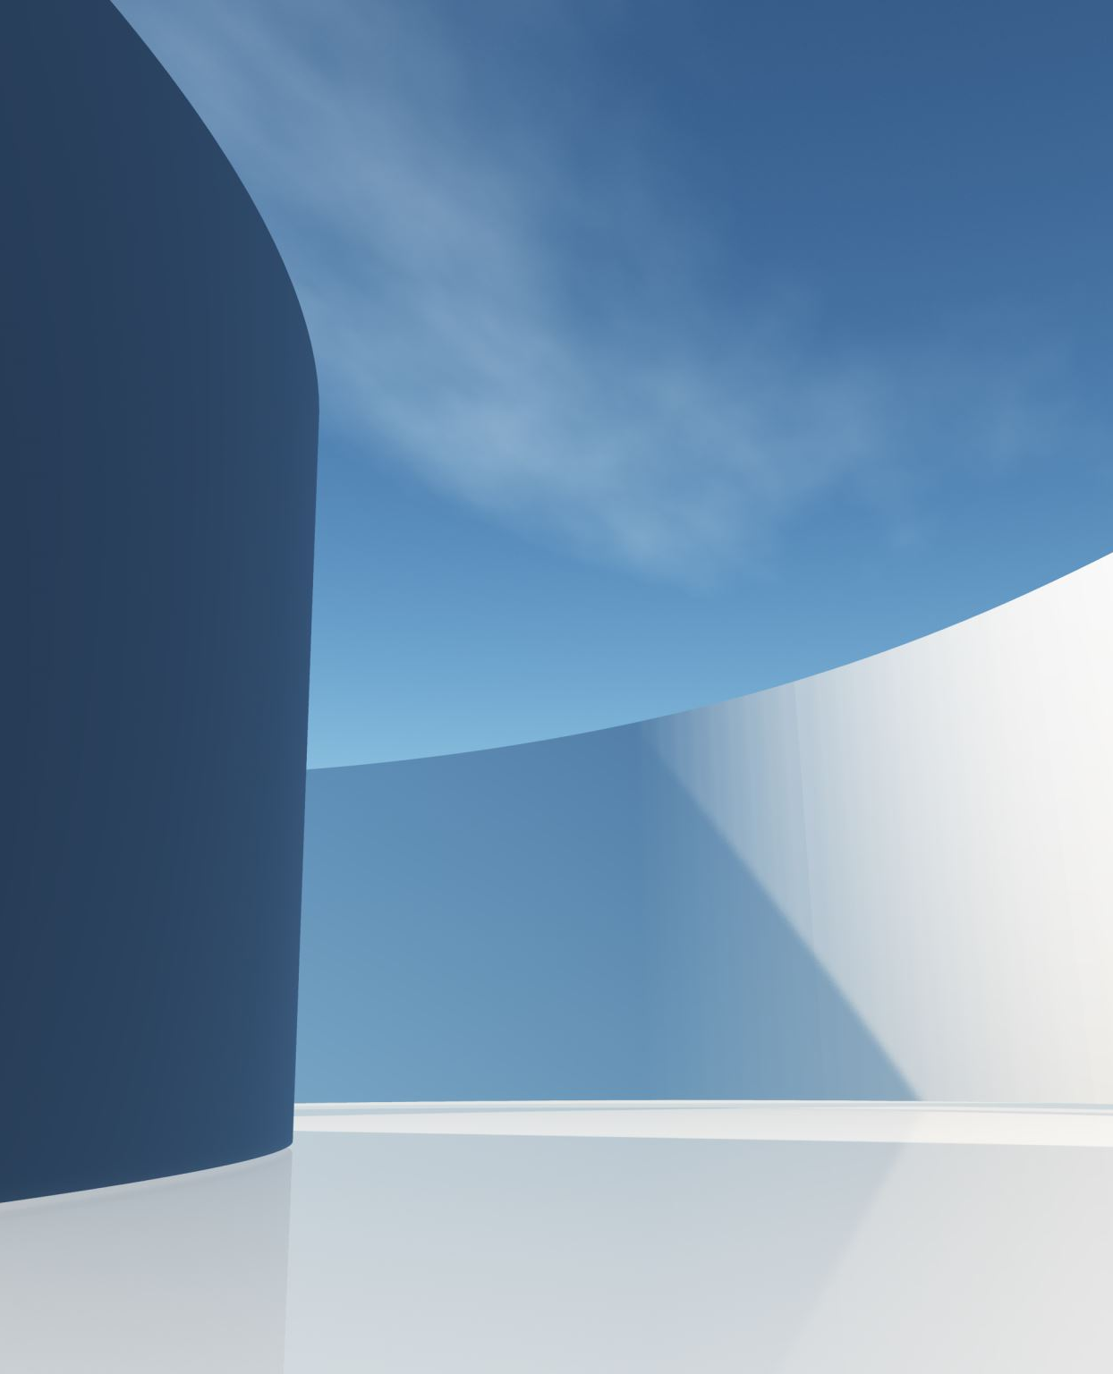
Description of the Feature Engineering
Make Training and Data Sets
Made 4 Variables
Dropped 12 variables
The final model used 15 variables out of the original 23
Recipe made dummy variables for all non-numeric variables

Slide 4

Model Comparison
Random Forest (Best)
Penalized Regression (Third Best)
BART (Second Best)

Slide 5

Description of the Best Model
How do Random Forests work?
Regression Tree
Multiple Trees
Used 500 trees
Tuned using expand.grid() function

Slide 6
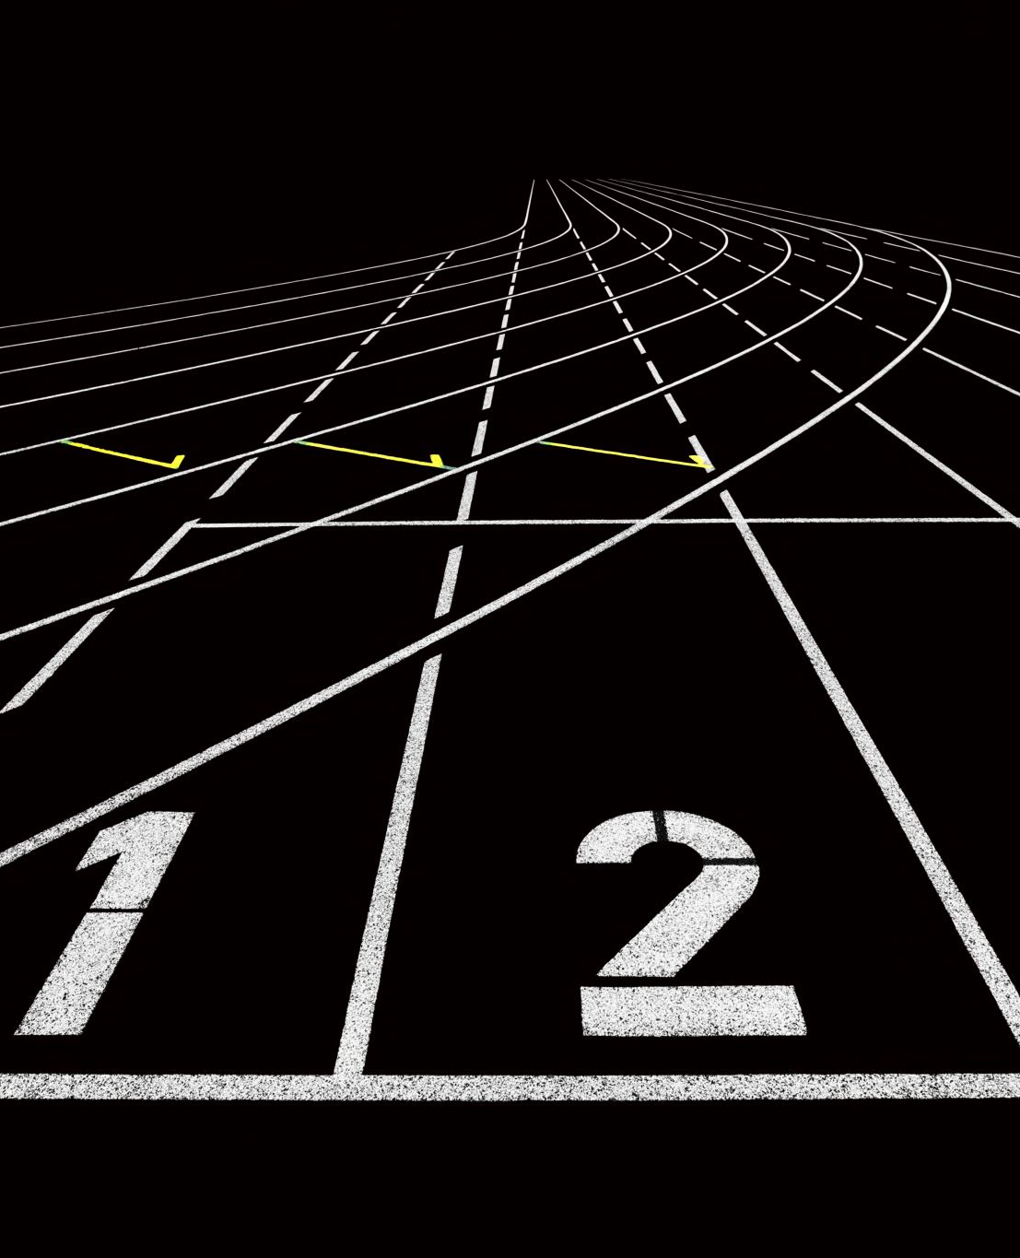
Final Score
0.60053
Threshold: 0.602

